Slide 1
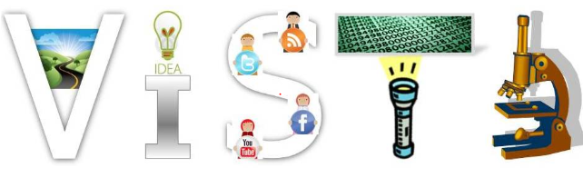
Fashion Recommendation Using Social Media Data
Haitian Zhang, Jong Hwi Park, Kefei Wu, Jiebo Luo
University of Rochester
Visual Intelligence & Social Multimedia Analytics Research Group

Slide 2
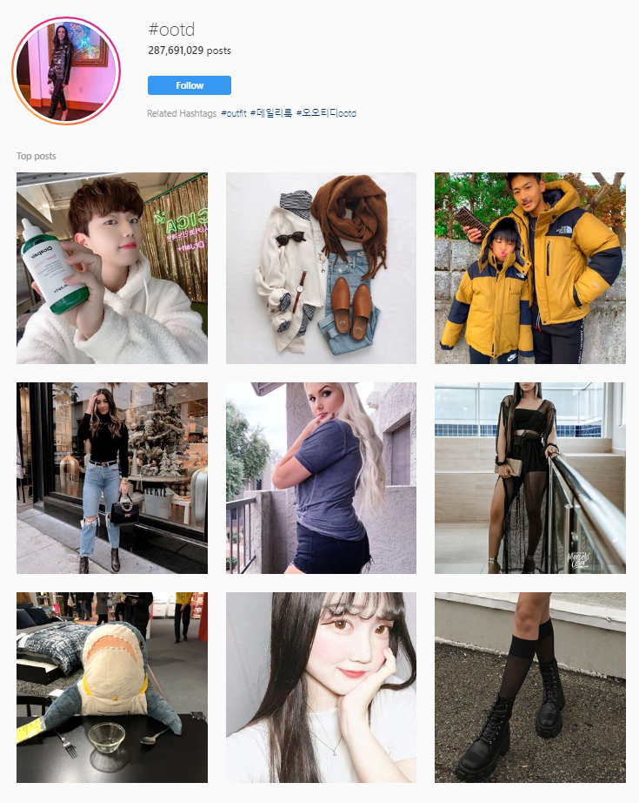
Motivation / Goal
Total sales revenue of online fashion retailers : $765 Billion Dollars (2018)
Wide availability of internet and mobile devices allow people to shop easily with decent prices
People like to share their looks on SNS!
Many people struggle with choosing/buying outfits
Fashion recommendation based on history of individual’s selfie/fashion images is unprecedented

Slide 3
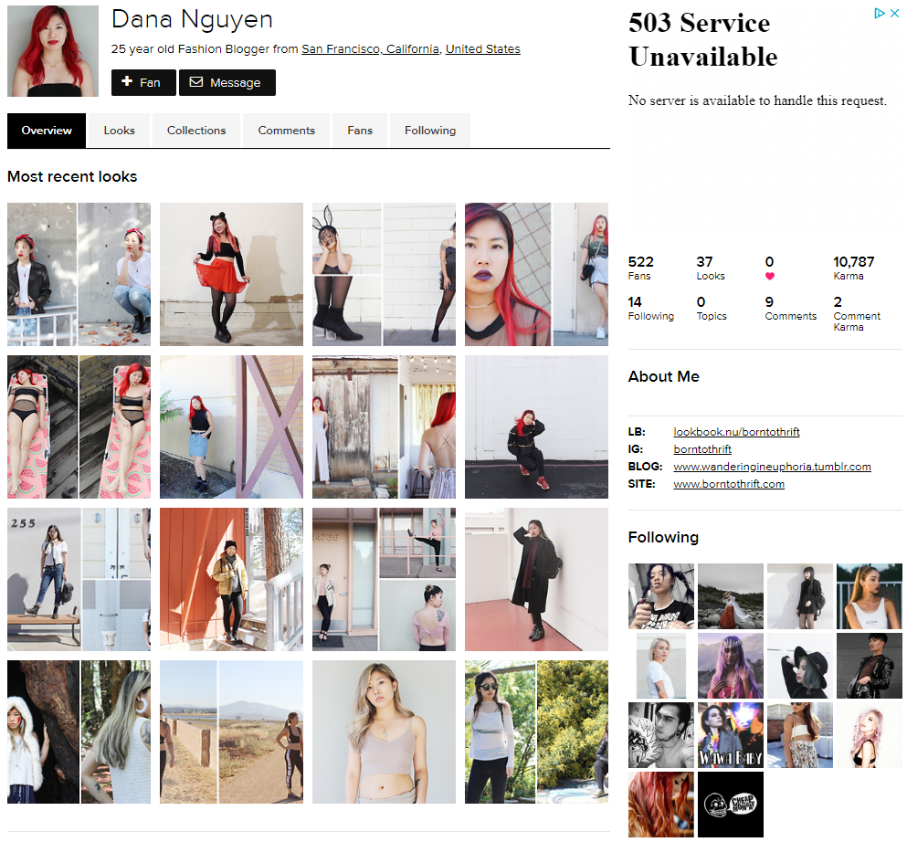
Dataset
Source: Lookbook.nu
Crawled: 4000 Users
Used Scrapy to crawl pictures and user information (~ 48 hrs)
100 images from each user
User information such as hashtag, #fans, #following, country, etc are crawled
Currently, 600 Users were used

Slide 4
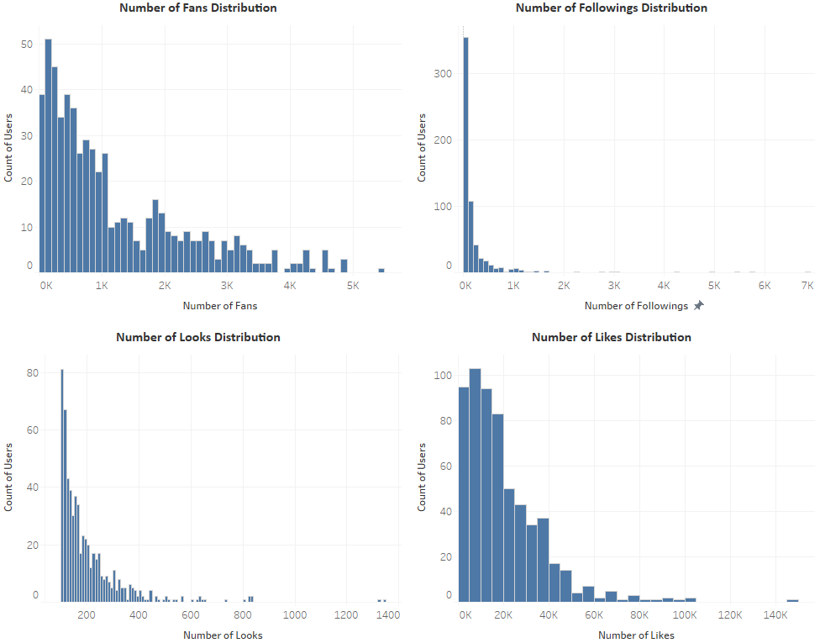
Dataset
Overview
# Users
# Users
Only user with fans 0 to 7,000 is crawled & 100+ pictures
User with more than 7,000 fans were mostly commercial account
All of the distributions are right skewed
Number of Fans
Number of Following
# Users
# Users
Number of Looks
Number of Likes

Slide 5
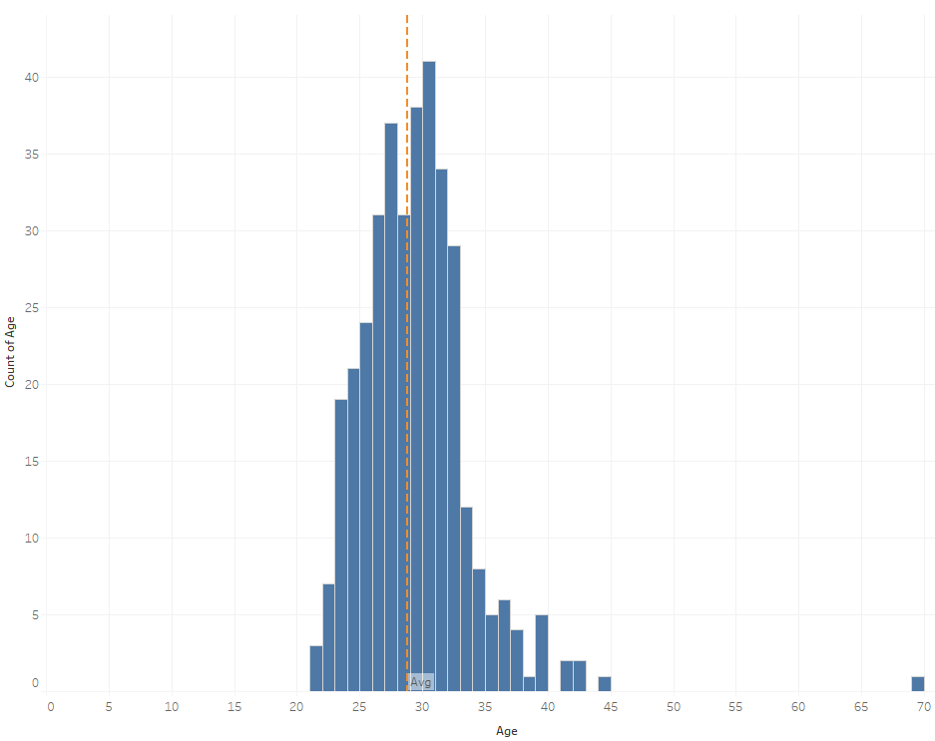
Dataset
Overview
Only 363 users out of 600 users mentioned their age in personal information
Average age = 28.83
Most of the users are age 29 and 30.
# Users
Age

Slide 6
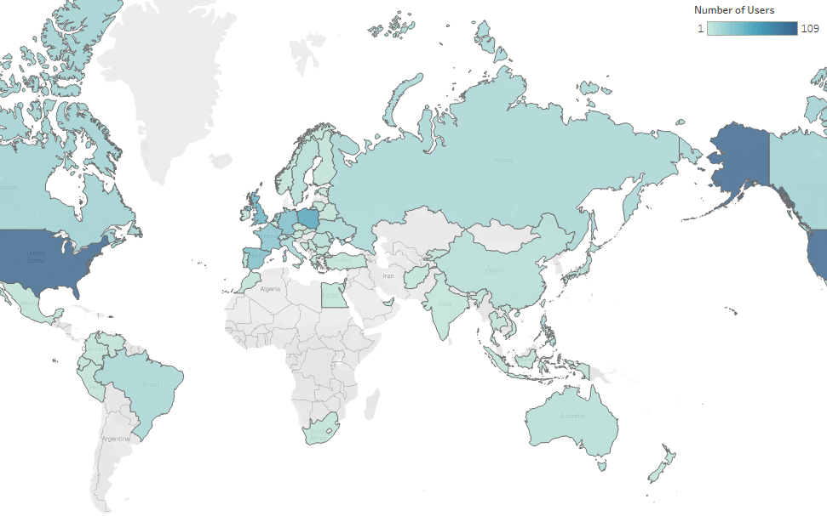
Dataset
Overview
109 users from United States
59 from Poland
46 from United Kingdom
38 from Spain
38 from Germany
31 from France

Slide 7
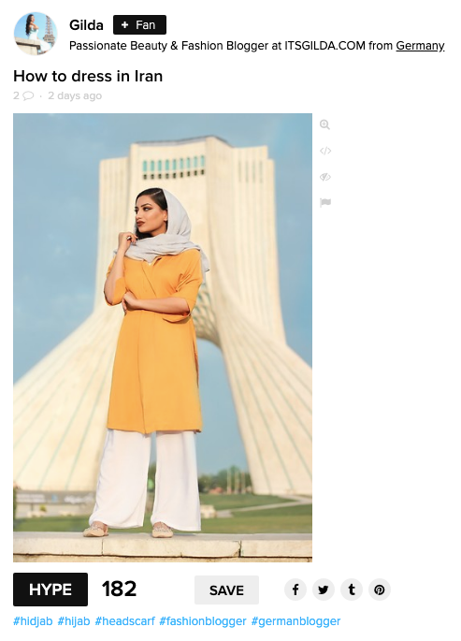
Data Format
In one image, it contains two formats of data:
Image
Words (Title,Hashtag)
To utilize both image and text data, we use image embedding and text embedding and extract feature

Slide 8
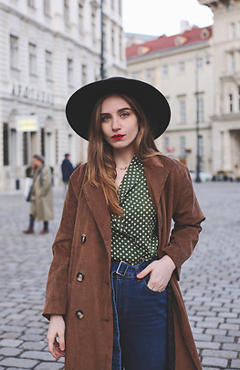
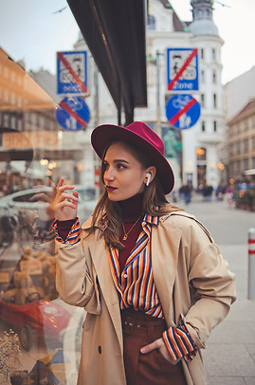
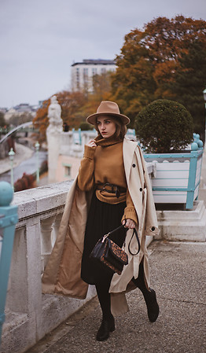
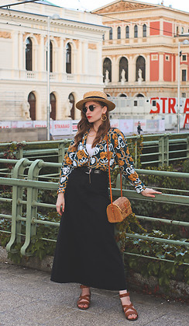
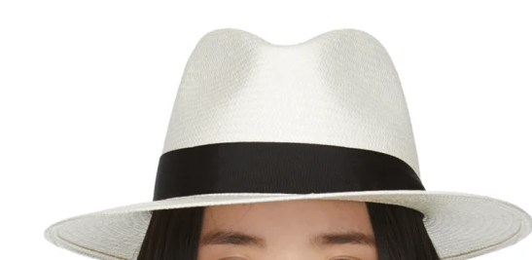
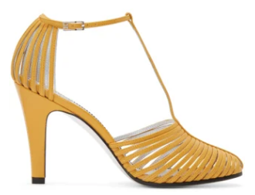
Recommendation Task
Example User
Street Vibe
#ootd,
#streeview,
#scarlet
Fall is coming
#fallscene
#chillvibe
Prague
#holiday
#chic
#sunglasses
?
?
Given the previous posts of a user,
Task 1 : recommend a new clothing image
Task 2 : recommend a new item

Slide 9
Street Vibe
#ootd,
#streeview,
#scarlet
Fall is coming
#fallscene
#chillvibe
Prague
#holiday
#chic
#sunglasses
?
?

Slide 10
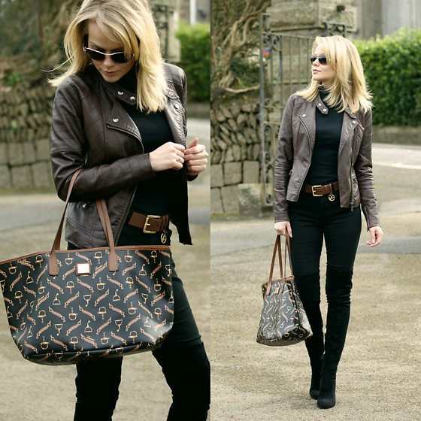
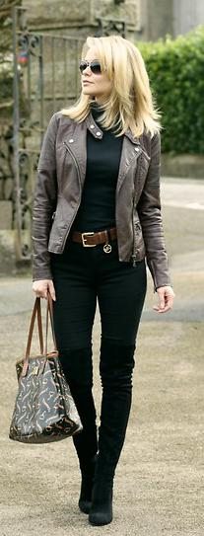
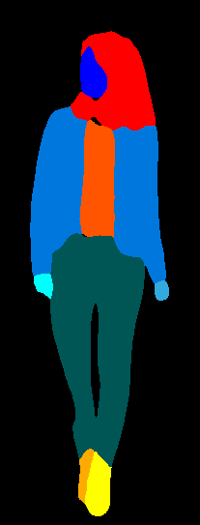
Data Pre-processing
A lot of pictures have multiple pictures concatenated
Yolo-V3 [1] with Darknet-53 backbone model was used to crop a person(selfie) with highest confidence score
Parsing through each item is needed through item segmentation
Fashion item segmentation was employed via JPPNet [2], resulting in 19 possible segmentations
However, 7 body part labels are excluded and Right/Left Shoe are combined, resulting in 11 segmentations

Slide 11
Feature Extraction - word hashtags
["#blackoutfit", "#chic", "#classy", "#weartowork", "#sweater"]
Wikipedia pretrained GloVe [4] word embedding was used to extract 300-d features from hashtag. The features are averaged to generate a 300-d feature.
Viterbi algorithm
["black", "outfit", "chic", "classy", "wear", "to", "work","sweater"]
GloVe
embedding
averaging

Slide 12
Feature Extraction - word titles
"Red, white, and jazz"
Same GloVe method from hashtag feature extraction was used to extract 300-d features from titles after applying RegEx and splitting strings. The features are averaged to generate a 300-d feature.
RegEx, split
"red” “white” “and” “jazz"
GloVe
embedding
averaging

Slide 13
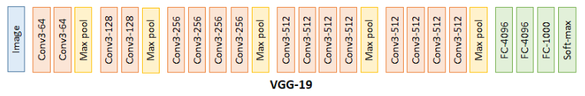
Feature Extraction - image
ImageNet pretrained VGG-19 [3] model was used to extract features from intermediate layers. Extracted features were gathered from each segmentation map.

Slide 14
Our Approach
Extract
image
features
Image
Title
#hashtags
Image
Title
#hashtags
Image
Title
#hashtags
KNN
search
A prefered clothing image
User #1
...
Our approach:
Use to represent feature of each body parts
e.g. shirt, trouser
Use to represent title/ hashtags features
Extract image features
KNN search from image pool
For task #1, use all features for to search closest image
Notes:
For task #2, use parts feature to search closest body parts

Slide 15
Our Model #1
Image
Title
#hashtags
Image
Title
#hashtags
Image
Title
#hashtags
Image
Title
#hashtags
Model
Feature extraction with MLP
Max-pooling to reduce feature dimensionalities
Training Loss:
MSE loss from ground-truth
User
posts
...
2-layer
MLP
Max pooling
fc layer

Slide 16
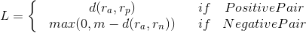
Our Model #2
positive
negative
Image
Title
#hashtags
Image
Title
#hashtags
Image
Title
#hashtags
Image
Title
#hashtags
Image
Title
#hashtags
User #1
...
2-layer
MLP
average pooling
Model
Feature extraction with MLP
average-pooling to get user feature
Training Loss:
Contrastive loss

Slide 17
Our Model #3
positive
negative
Image
Title
#hashtags
Image
Title
#hashtags
Image
Title
#hashtags
Image
Title
#hashtags
Image
Title
#hashtags
User #1
...
2-layer
MLP
Weighted average pooling
Model
Feature extraction with MLP
Attentional-weighted average-pooling to get user feature
Training Loss:
Contrastive loss

Slide 18
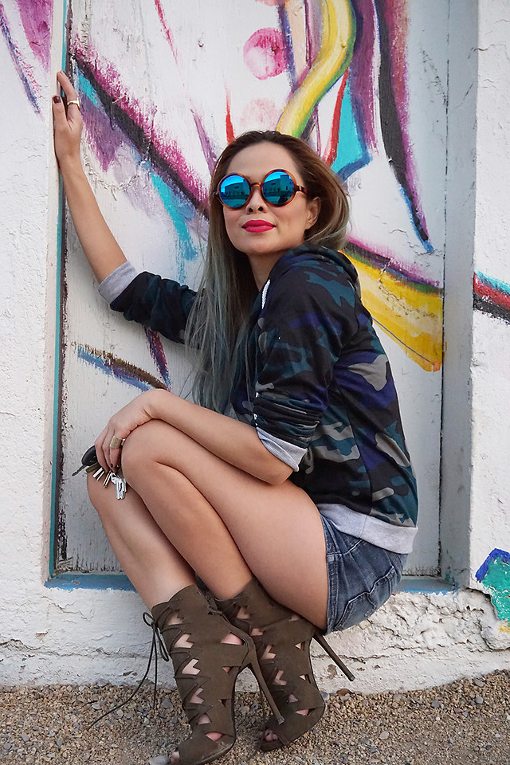
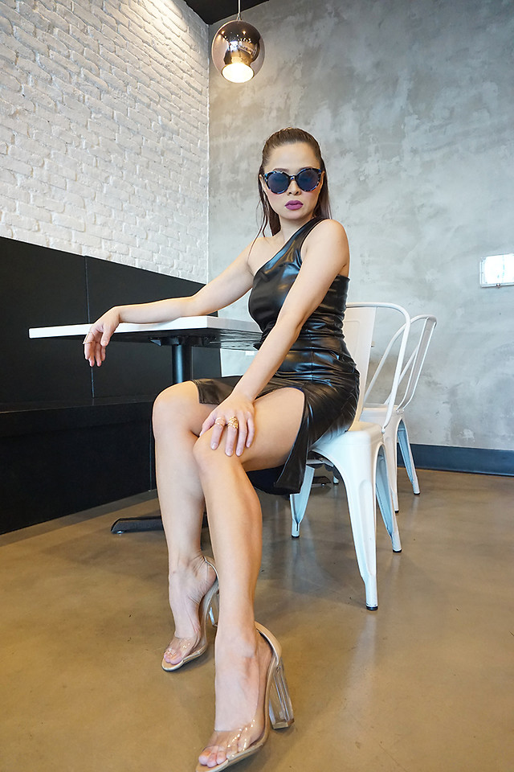
Data preparation and evaluation
Train/test split
For each user,
(N-1) posts for training
Last post for testing
Input/output split
For (N-1) posts
A random post as ground truth
Other (N-2) posts as inputs
Evaluation
For each user, recommend image from the N test image.
Image
Title/#hashtags
Image
Title/#hashtags
Image
Title/#hashtags
Image
Title/#hashtags
User #1
...
Post #1
Post #2
Post #N-1
Post #N
Image
Title/#hashtags
Image
Title/#hashtags
Image
Title/#hashtags
Image
Title/#hashtags
User #2
...
Post #1
Post #2
Post #N-1
Post #N
...
Image
Title/#hashtags
Image
Title/#hashtags
Image
Title/#hashtags
Image
Title/#hashtags
User #M
...
Post #1
Post #2
Post #N-1
Post #N
Inputs
Ground
truth
Test

Slide 19
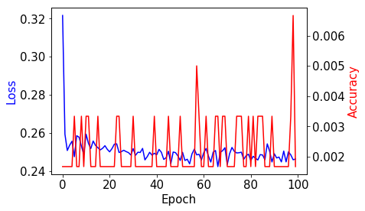
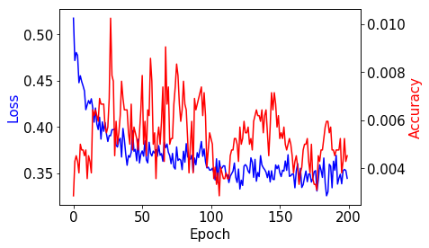
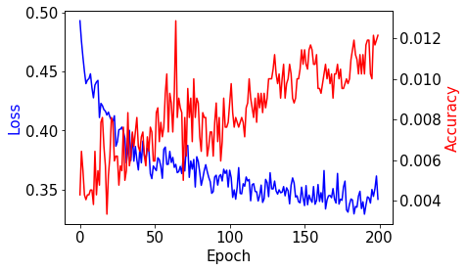
Modeling Result
 | Model 1 | Model 2 | Model 3
Highest Acc | 0.0067 | 0.0102 | *0.0128
Model 1
Epoch = 100
Model 2
Epoch = 200
Model 3
Epoch = 200

Slide 20
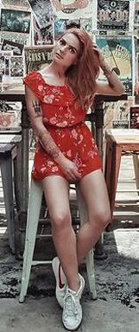
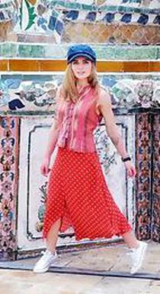
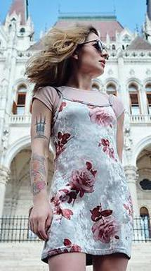
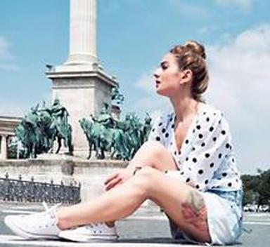
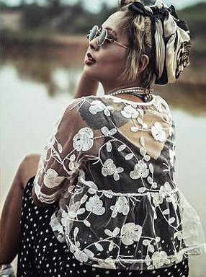
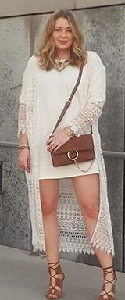
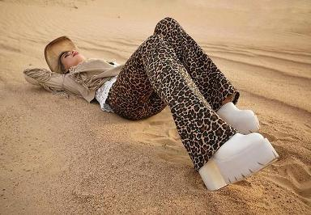
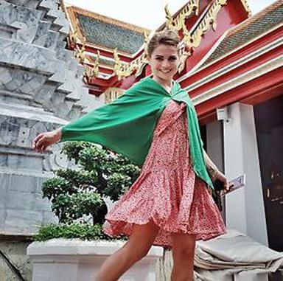
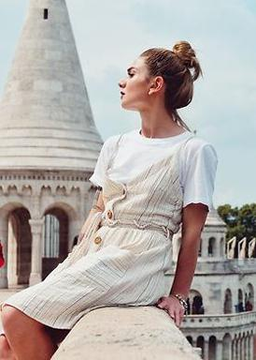
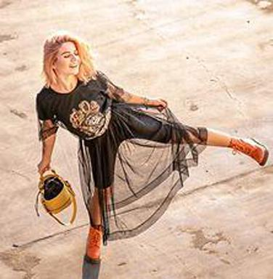
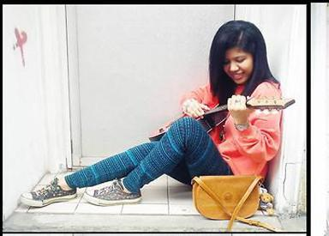
Example recommendation results
Input Output
1
2
3

Slide 21
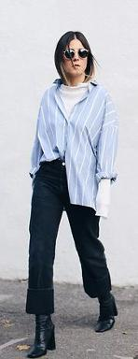
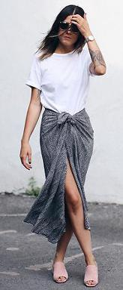
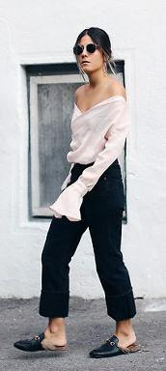
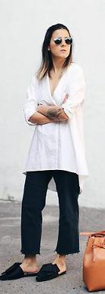
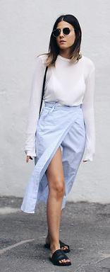
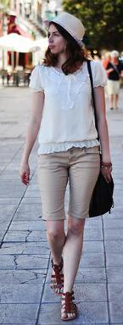
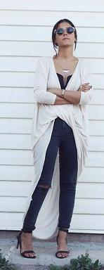
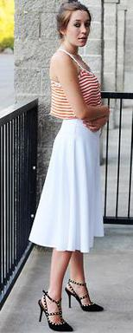
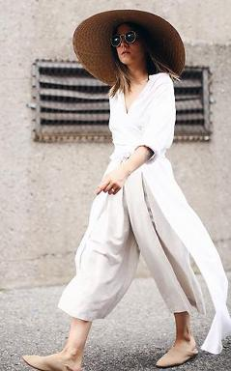
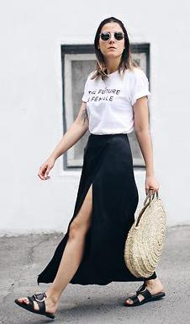
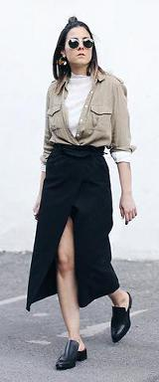
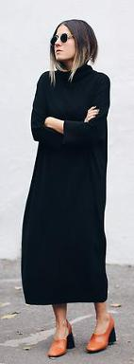
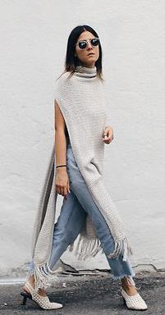
Example recommendation results
Input Output
1
2
3

Slide 22
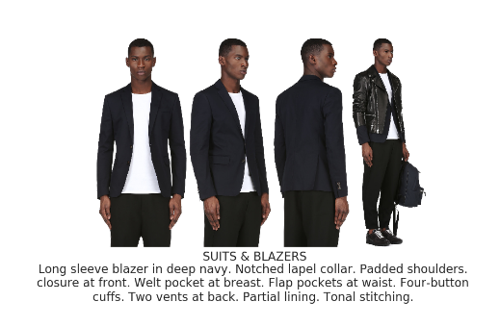
Future Plan
Use SSENSE dataset to recommend new/high-fashion items curated by fashion experts
Establish method for recommending individual items (Task 2)
Employ various Recommendation systems
Deep interest Network
Metric learning
Kernel method

Slide 23
Acknowledgement
Professor Jiebo Luo - University of Rochester
Zhuang Tian - Goergen Institute of Data Science
Lookbook.nu
SSENSE.com

Slide 24
References
[1] YOLOv3: An Incremental Improvement, arxiv, 2018
[2] Look into Person: Joint Body Parsing & Pose Estimation Network and A New BenchMark, in IEEE Transactions on Pattern Analysis and Machine Intelligence, 2019
[3] Very Deep Convolutional Networks For Large-Scale Image Recognition, in ICLR, 2015
[4] GloVe: Global Vectors for Word Representation, in EMNLP, 2014

Slide 25
Our Approach
Predict
image
feature
Image
Title
#hashtags
Image
Title
#hashtags
Image
Title
#hashtags
KNN
search
A prefered clothing image
User #1
...
Our approach:
Use to represent feature of each body parts
e.g. shirt, trouser
Use to represent hashtags feature
Predict new image features
KNN search from image pool
For task #1, use all features for to search closest image
K-NN search
for each feature
Prefered clothing parts from multiple images
E.g. shirt from image A,
trouser from image B.
Notes:
For task #2, use parts feature to search closest body parts

